Slide 1


Slide 2


A platform where you understand your house selections comprehensively

Slide 3


Analysis – Explain the Data

Slide 4





Analysis – Explain the Data
House
Description
House Style
# of Reviews
Longitude
Latitude
City
Neighborhood
Amenities
Dryer
WiFi
Pet Friendly
Single Day Price
Month Price
Room Type
Property

Slide 5




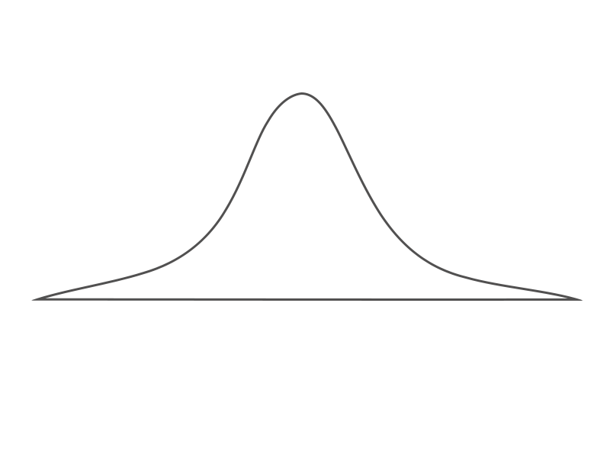


Analysis – Explain the Topic
You’re Here

Slide 6

Design and Research Process
Data Extraction
Bubble Map
Preprocessing
Bar Plot
Vue Integration
Data Exploring
Visualization
Histogram
Layout Adjustment
Bubble Plot
Present / Report
Format Design
Circular Bar Plot
Complete

Slide 7





Design Process – Tools
Data Extraction
Bubble Map
Preprocessing
Bar Plot
Integration
Data Exploring
Visualization
Histogram
Layout Adjustment
Bubble Plot
Present / Report
Format Design
Circular Bar Plot
Complete

Slide 8
Who Did What
Data Extraction
Bubble Map
Ren
Ze
Preprocessing
Bar Plot
Integration
Ren
Ze
Data Exploring
Visualization
Histogram
Layout Adjustment
Bubble Plot
Present / Report
Format Design
Circular Bar Plot
Complete

Slide 9
Who Did What
Wei
Fan
Data Extraction
Bubble Map
Wei
Fan
Wei
Fan
Preprocessing
Bar Plot
Integration
Data Exploring
Visualization
Histogram
Layout Adjustment
Bubble Plot
Present / Report
Format Design
Circular Bar Plot
Complete

Slide 10
Who Did What
Yen
Chen
Data Extraction
Bubble Map
Yen
Chen
Preprocessing
Bar Plot
Integration
Yen
Chen
Data Exploring
Visualization
Histogram
Layout Adjustment
Bubble Plot
Present / Report
Format Design
Circular Bar Plot
Complete

Slide 11
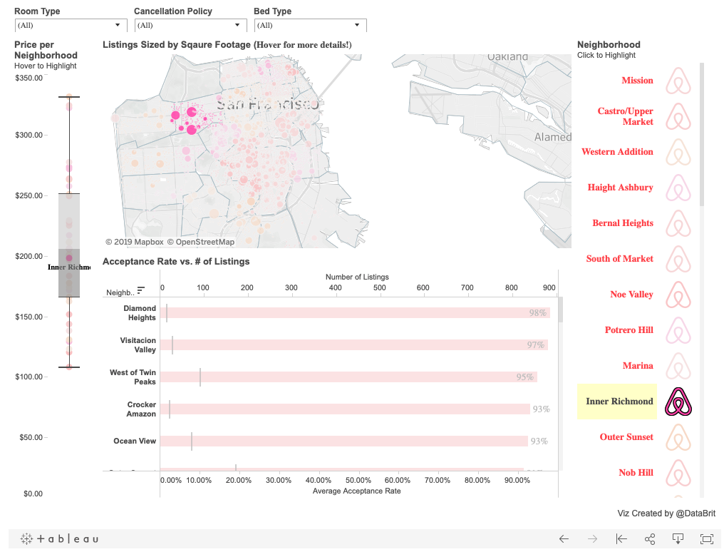
Research From Others

Slide 12
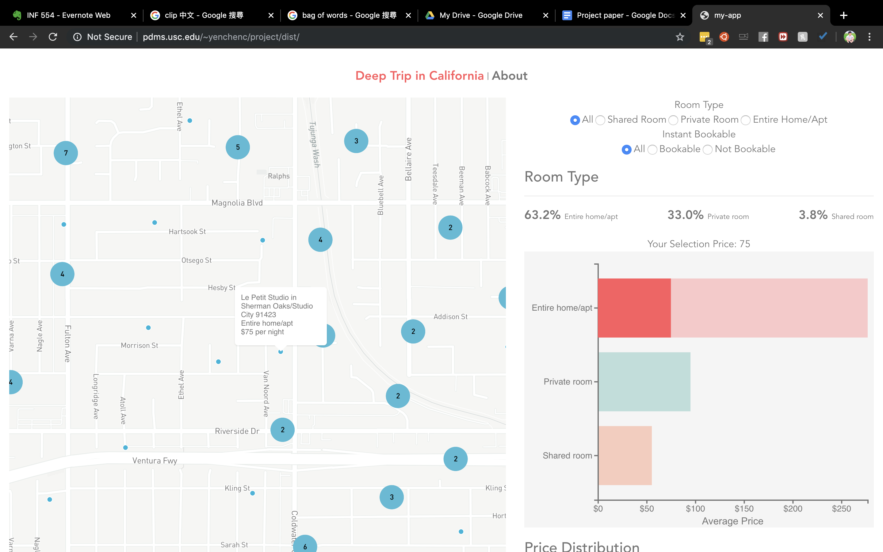


Our Difference
Map and plots are all interactive, transition, hover, responsive using bootstrap, layout included

Slide 13
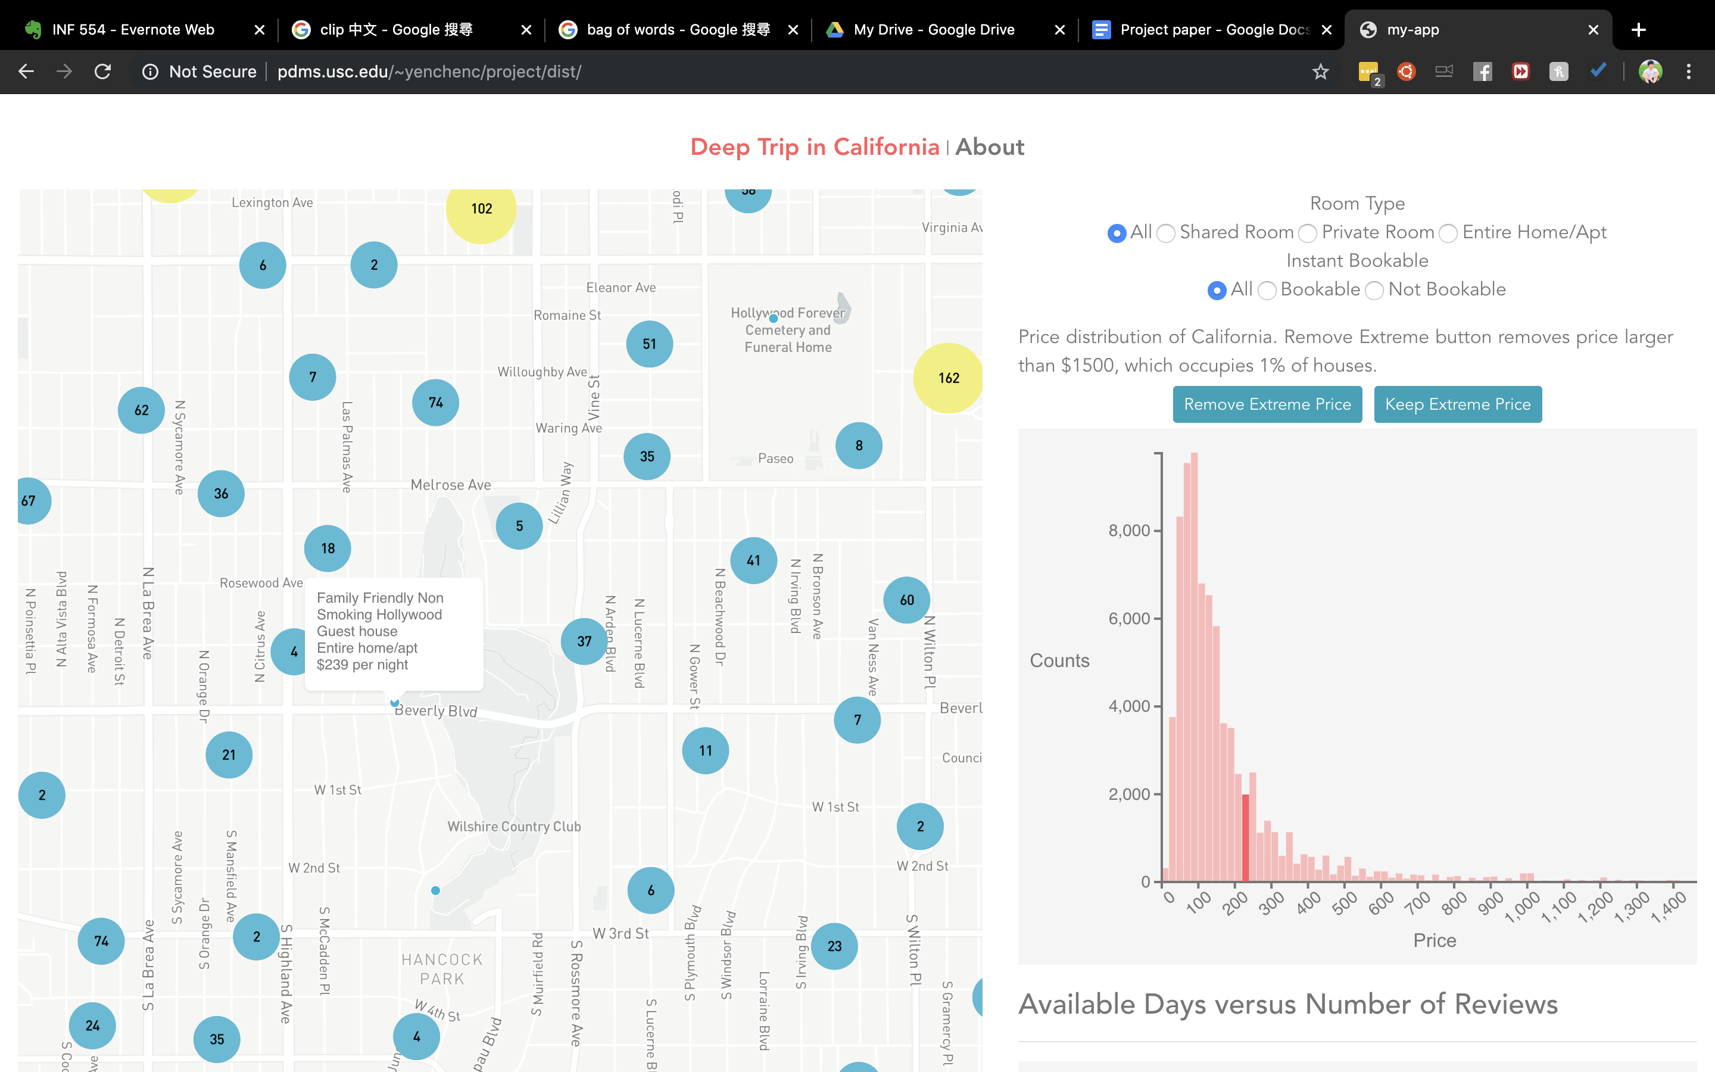
Our Difference
Map and plots are all interactive, transition, hover, responsive using bootstrap, layout included

Slide 14
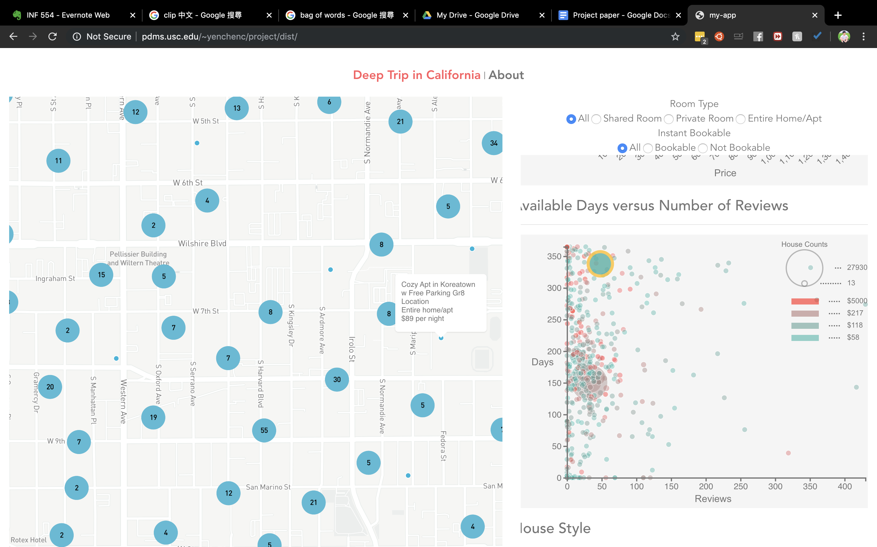
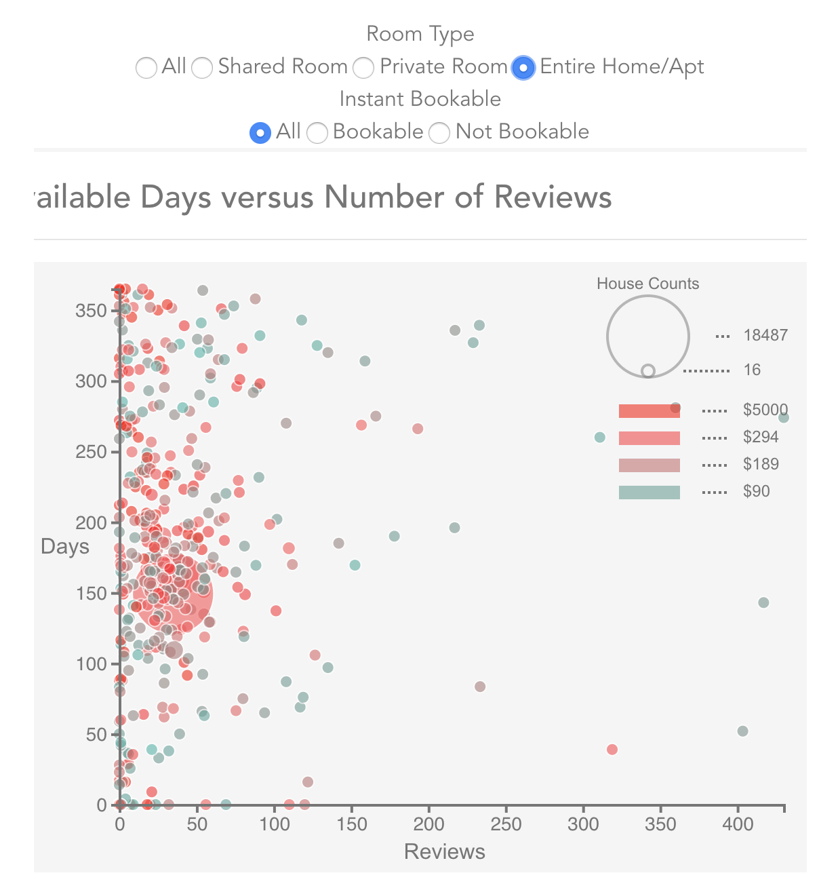

Our Difference
Map and plots are all interactive, transition, hover, responsive using bootstrap, layout included

Slide 15
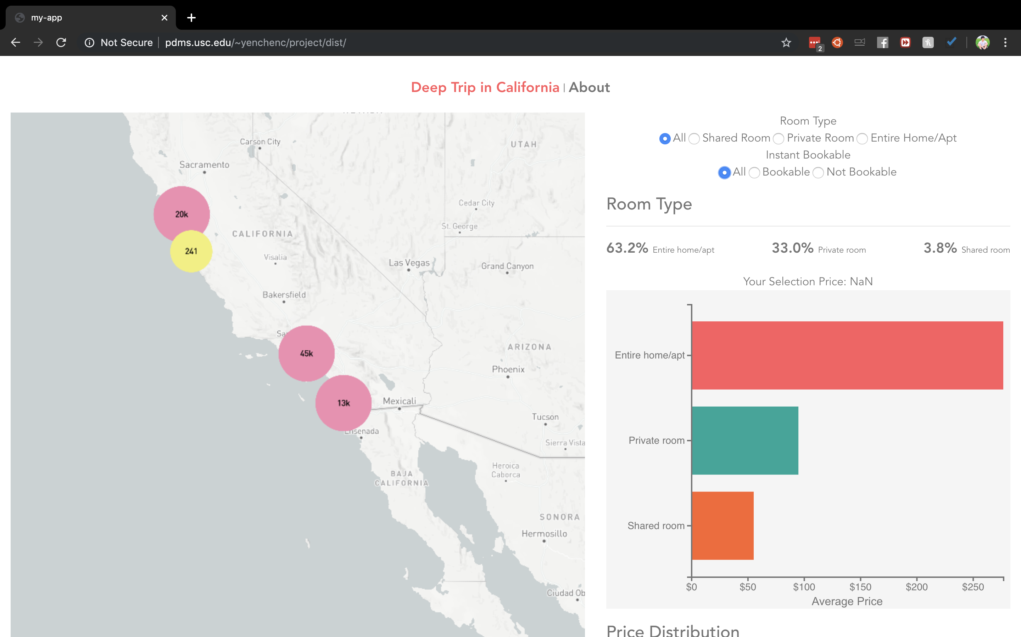
Layout
Map and plots are all interactive, transition, hover, responsive using bootstrap, layout included

Slide 16
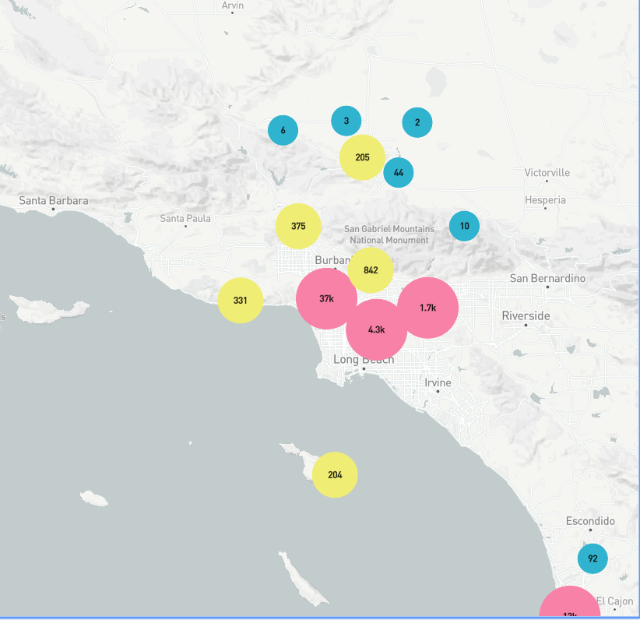
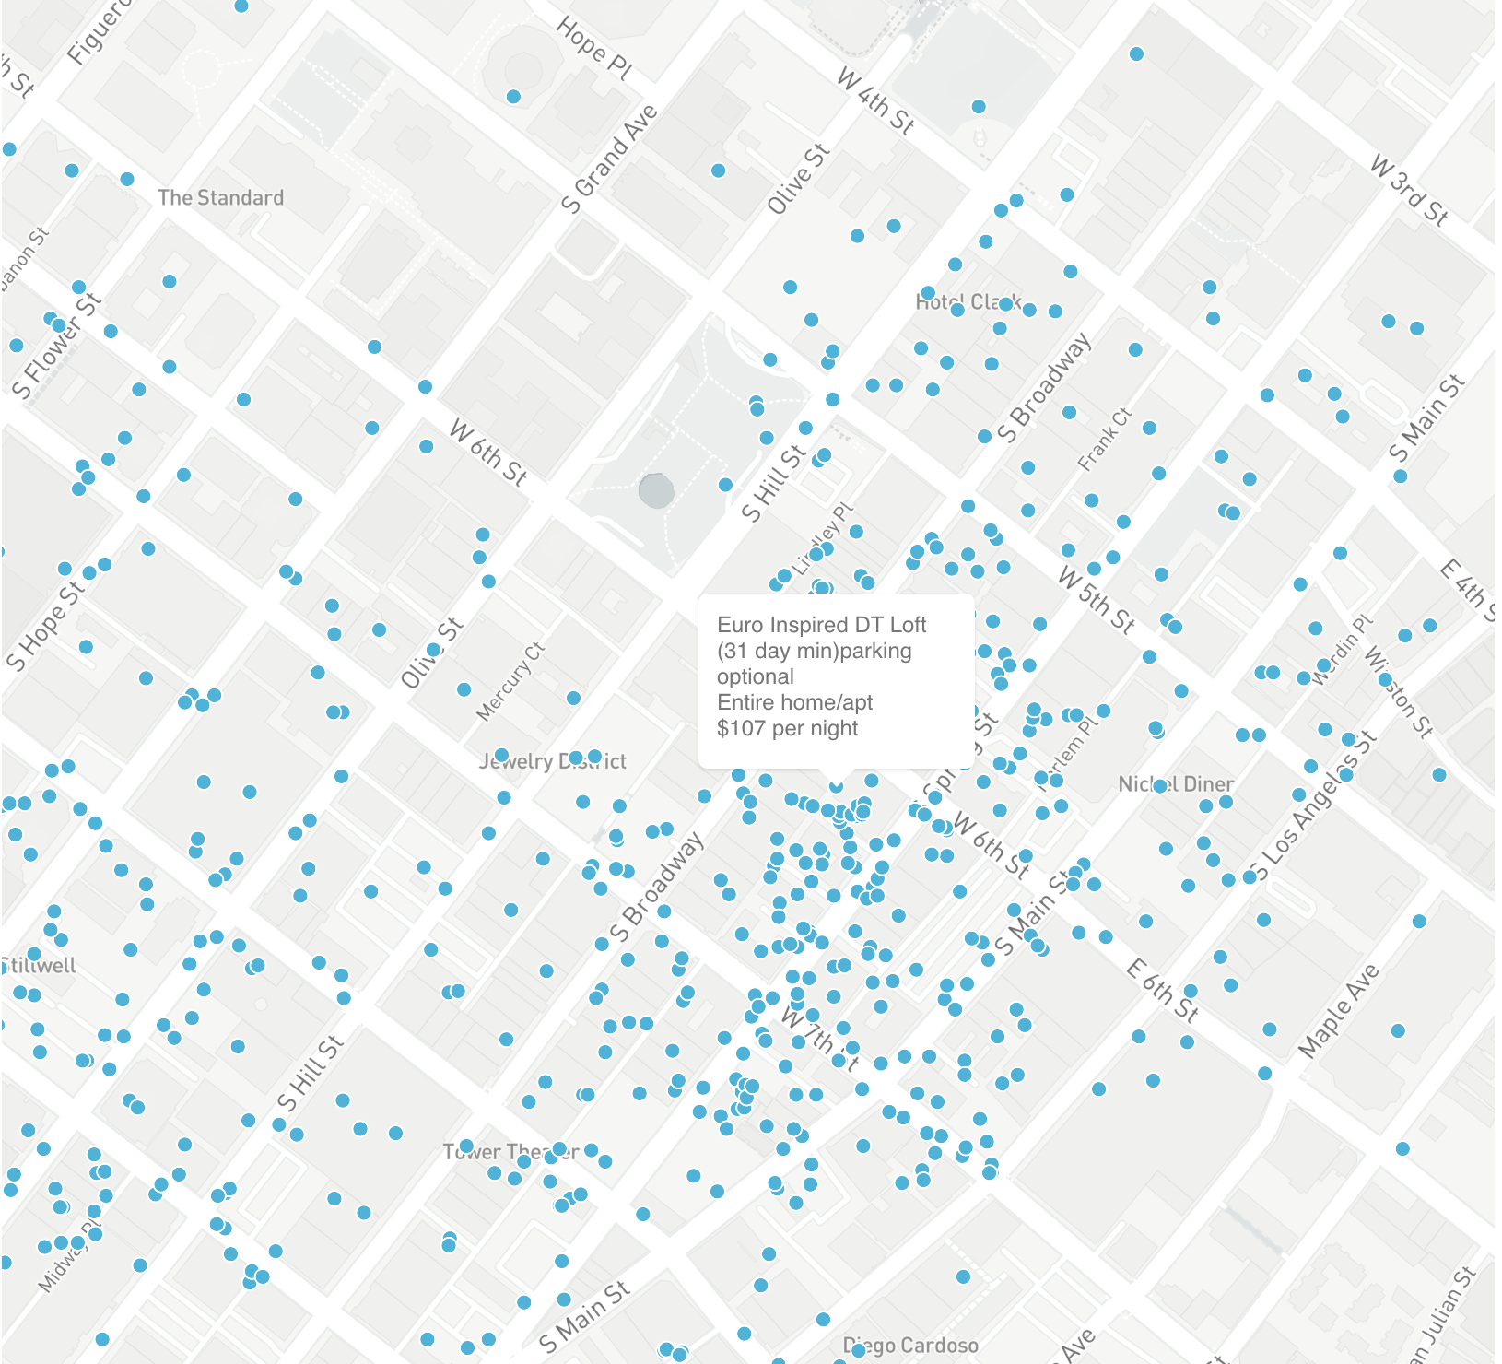
Bubble Map
Map includes interactive, transition, hover, responsive using bootstrap, layout included

Slide 17
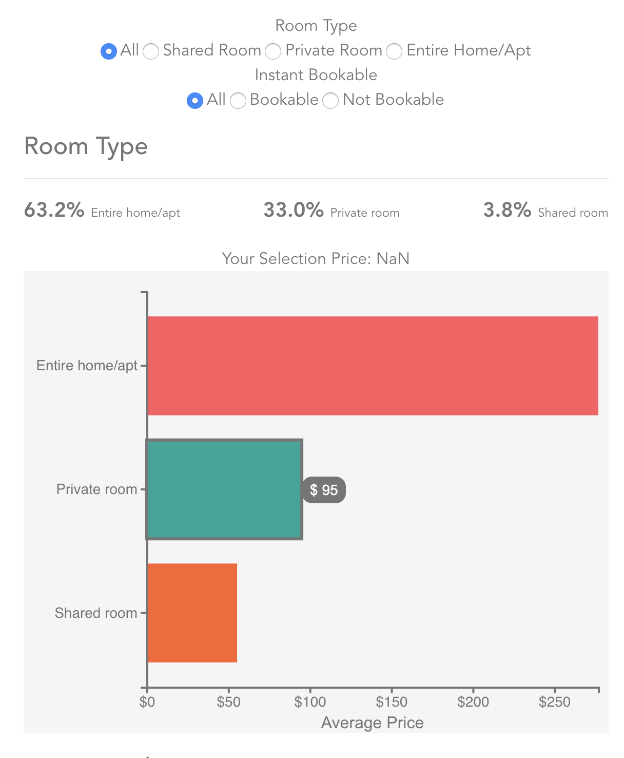
Bar Plot
Bar plot includes interactive, transition, hover, responsive using bootstrap, layout included

Slide 18
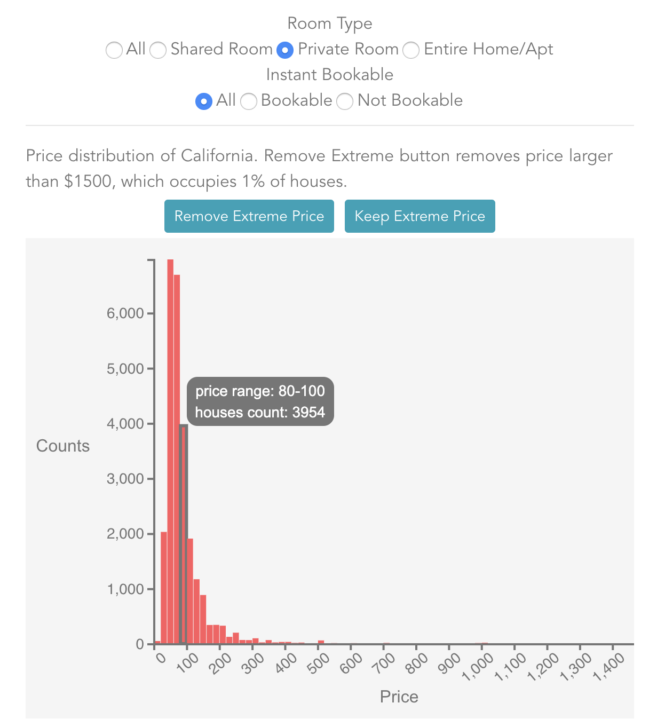
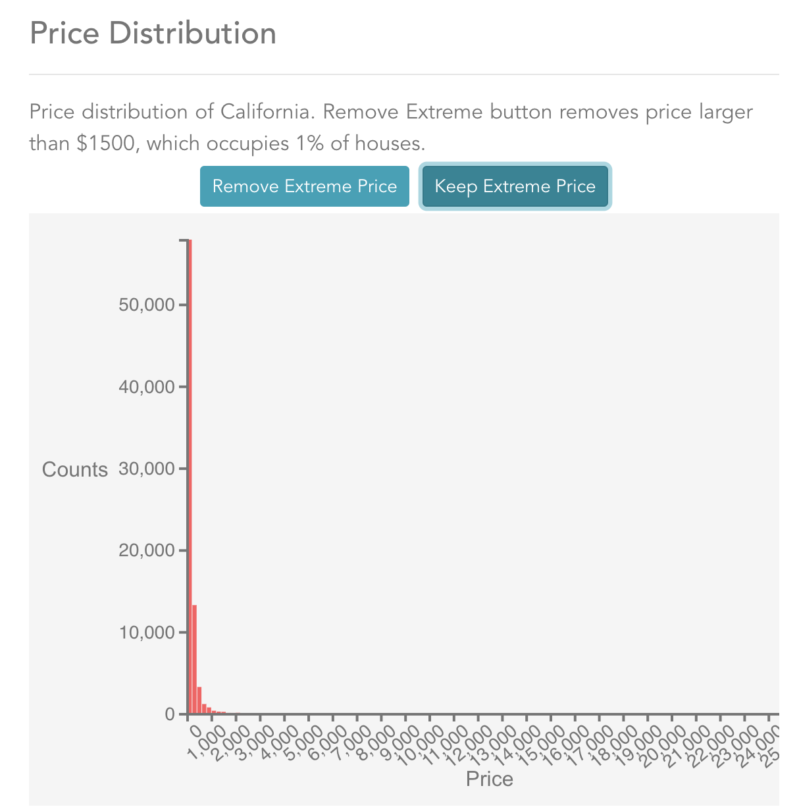
Histogram
Histogram includes interactive, transition, hover, responsive using bootstrap, layout included

Slide 19
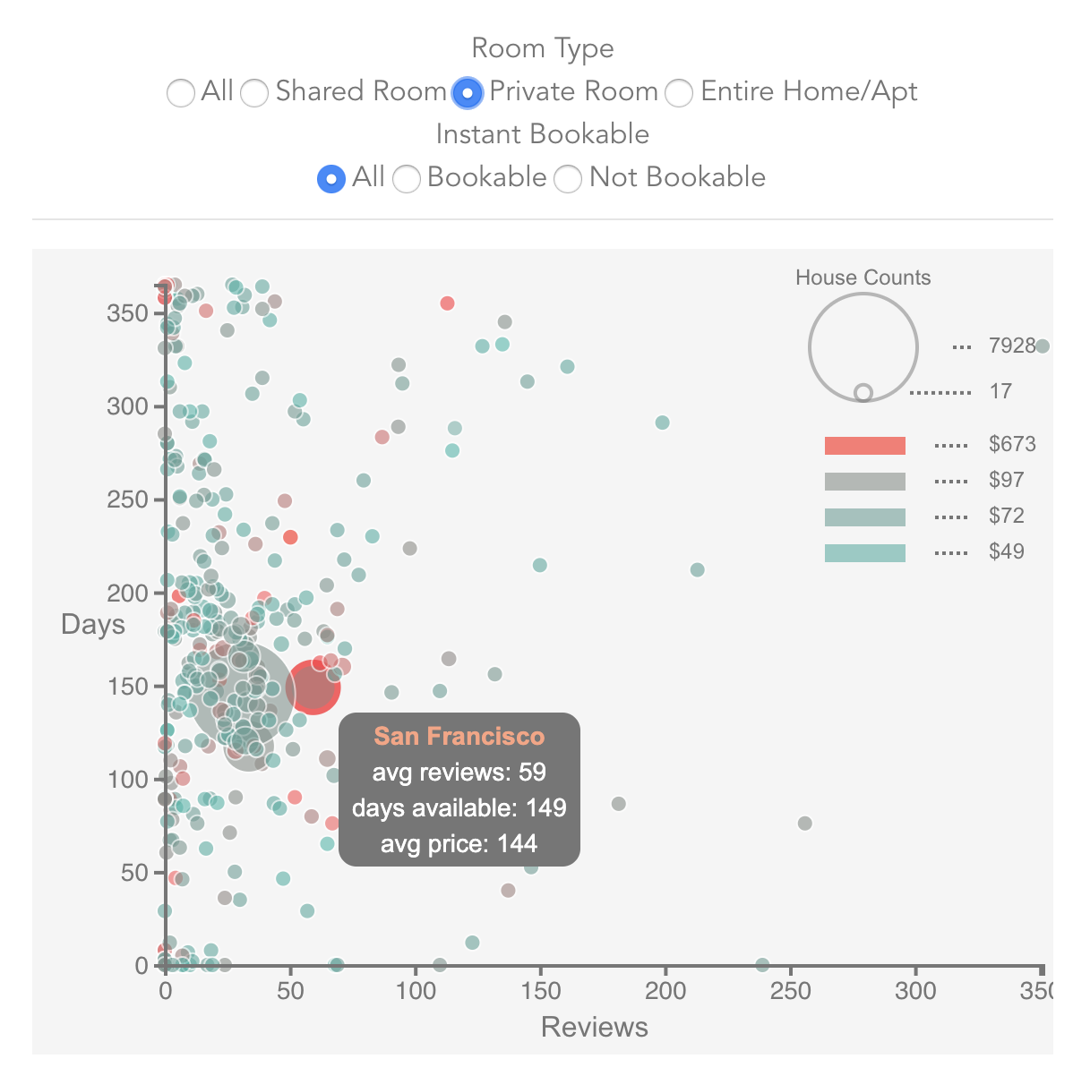
Bubble Plot
Bubble plot includes interactive, transition, hover, responsive using bootstrap, layout included

Slide 20
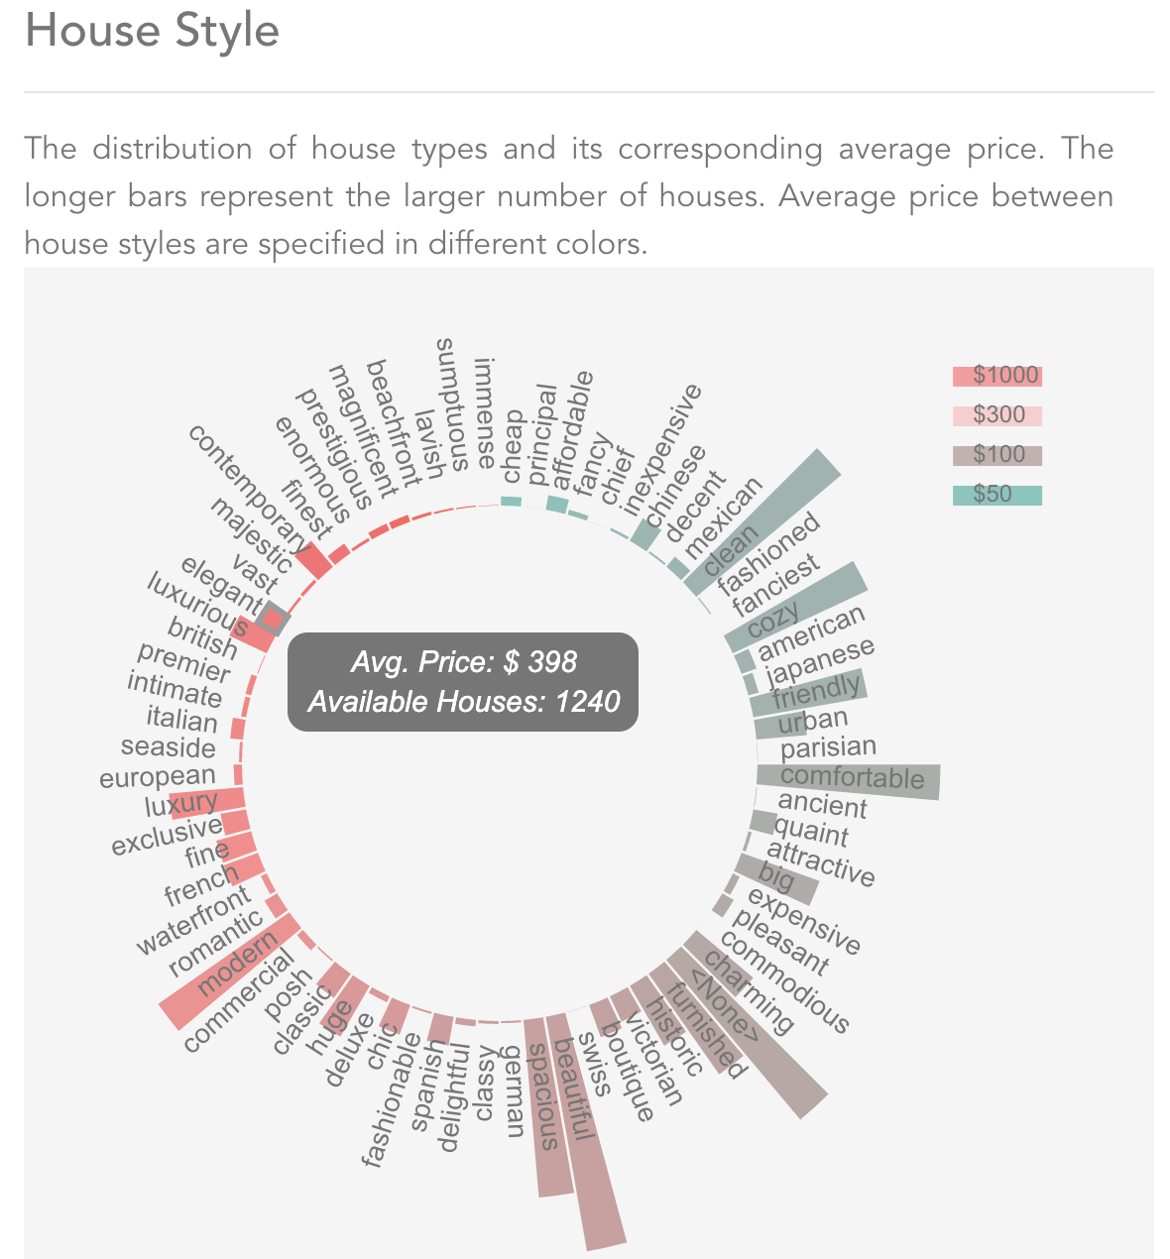
Circular Bar
Circular bar plot includes interactive, transition, hover, responsive using bootstrap, layout included

Slide 21
What we could have done differently

